Slide 1

ABFRL Brands-Exchange App Tagging
11th Oct 2023

Slide 2
Guidelines to Implement Tagging
Adobe Launch SDK should be installed before the custom tagging.
Copy and paste the keys of contextData as it is without changing the Camel Casing.
Context Data should be along with calling the Track State and Track Action functions.
<> this indicates dynamic value to be captured and passed.
Icid will be added to the next page’s URL where user lands after clicking any content of current page.
Testing will be performed by Implementation Team after ABFRL QA team will give the confirmation/sign off for the testing done by them.
UAT should be done first in staging and then in production post production UAT adobe’s codes are pushed to live.
For Customer ID, pass the value only when available else pass it as blank.

Slide 3
Super App Brands
Since Super App contains multiple cross-brands journey, therefore w.r.t to tracking the brand/product brand currently included( PFB the table with the expected value to be passed in the context data)
Brand/Product Brand | Datalayer Value
Van Huesen | vh
Peter England | pe
Allen Solly | as
Louis Phillipe | lp
Reebok | rbk
American Eagle | aeo
Forever 21 | f21
Simon Carter | sc

Slide 4
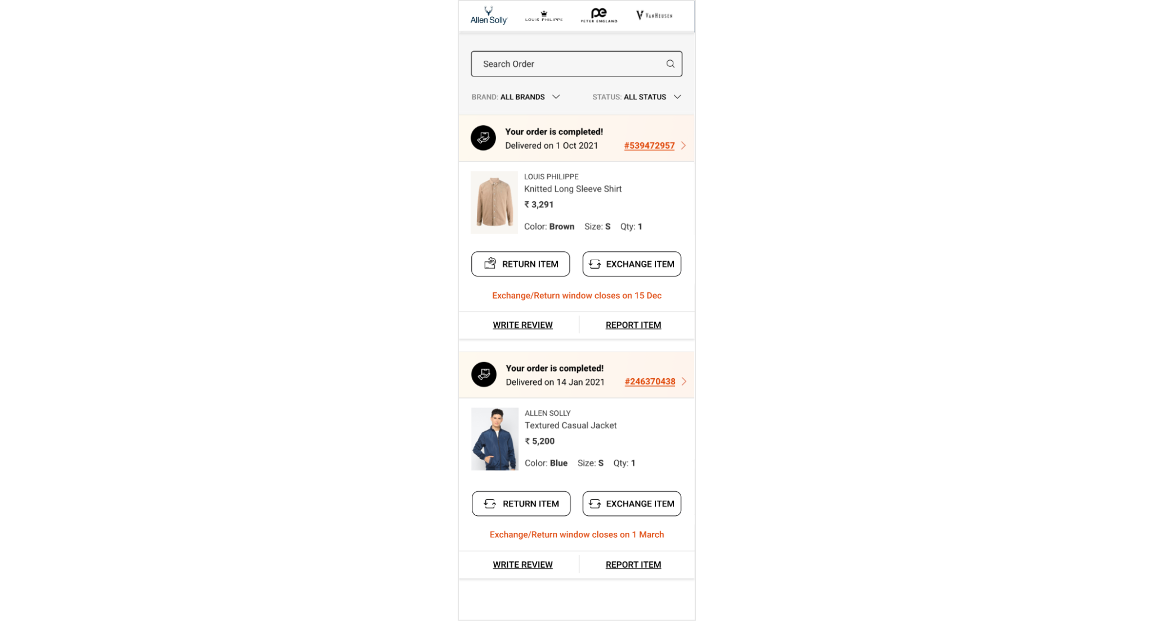
On load of My Orders page

Slide 5
Page type | Tracking type | Launch variables | Expected values
My orders | On load | let contextData={ pageName: “my orders page", channel: "<android/ios>|my account", customerID : "<customerID>", // only pass when available loginStatus : "<logged-in/guest>" , pageType : “my account - my orders page”, //my account-<pageName> platform: "<android/ios>", userDetails: "<gender>|<age>", // pass only when user has logged in dob: "<date of birth>" // pass only when user is logged in // pass only when user has logged in }; ACPCore.trackState(“my orders page", contextData); | loginStatus may have the values:- logged-in Guest

Slide 6
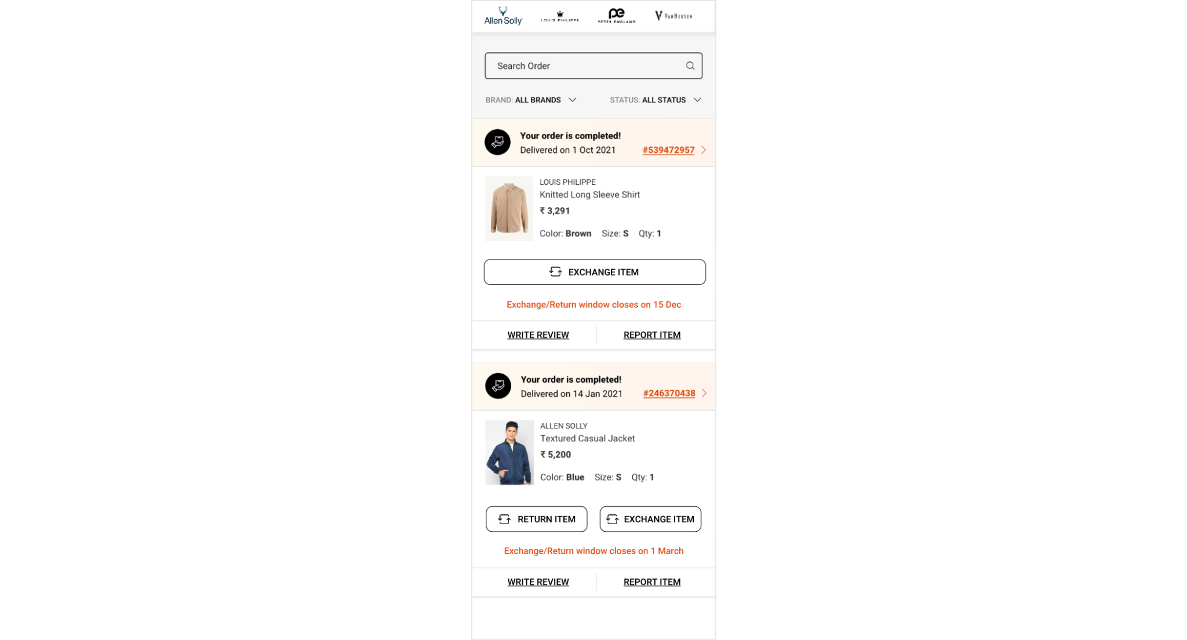
On exchange click

Slide 7
click type | Tracking type | Launch variables | Expected values
CTA clicks | button | let contextData={ linkName:“exchange item", channel: "<android/ios>|my account", linkPageName: “my orders page", customerID : "<customerID>", // only pass when available loginStatus : "<logged-in/guest>" , platform: "<android/ios>", &&products : ";<product id>;;;;eVar19 = <product category>|eVar30=<product name>|eVar32=<product brand name>”,​ userDetails: "<gender>|<age>", // pass only when user is logged in dob: "<date of birth>" // pass only when user is logged in }; ACPCore.trackAction(“exchange item", contextData); | loginStatus may have the values:- logged-in Guest

Slide 8
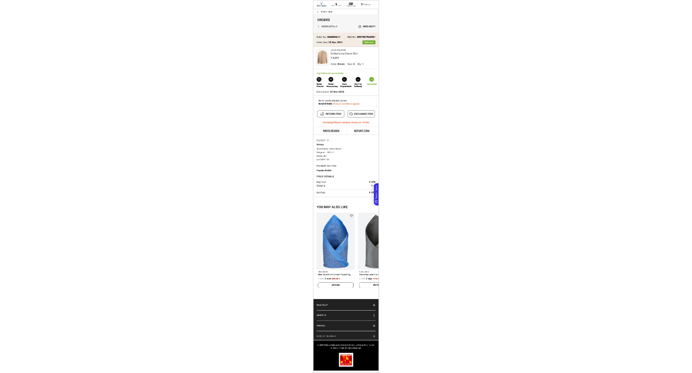
Product Page in my orders

Slide 9
Page type | Tracking type | Launch variables | Expected values
Order Product Page | On load | let contextData={ pageName: “order product page”, channel: "<android/ios>|my account", customerID : "<customerID>", // only pass when available loginStatus : "<logged-in/guest>" , pageType : “my account - my orders page”, //my account-<pageName> platform: "<android/ios>", &&products : ";<product id>;;;;eVar19 = <product category>|eVar30=<product name>|eVar32=<product brand name>”,​ userDetails: "<gender>|<age>", // pass only when user has logged in dob: "<date of birth>" // pass only when user is logged in // pass only when user has logged in }; ACPCore.trackState(“order product page", contextData); | loginStatus may have the values:- logged-in Guest

Slide 10
On exchange click

Slide 11
click type | Tracking type | Launch variables | Expected values
CTA clicks | button | let contextData={ linkName:“exchange item", channel: "<android/ios>|my account", linkPageName: “my orders page", customerID : "<customerID>", // only pass when available loginStatus : "<logged-in/guest>" , platform: "<android/ios>", &&products : ";<product id>;;;;eVar19 = <product category>|eVar30=<product name>|eVar32=<product brand name>”,​ userDetails: "<gender>|<age>", // pass only when user is logged in dob: "<date of birth>" // pass only when user is logged in }; ACPCore.trackAction(“exchange item", contextData); | loginStatus may have the values:- logged-in Guest

Slide 12
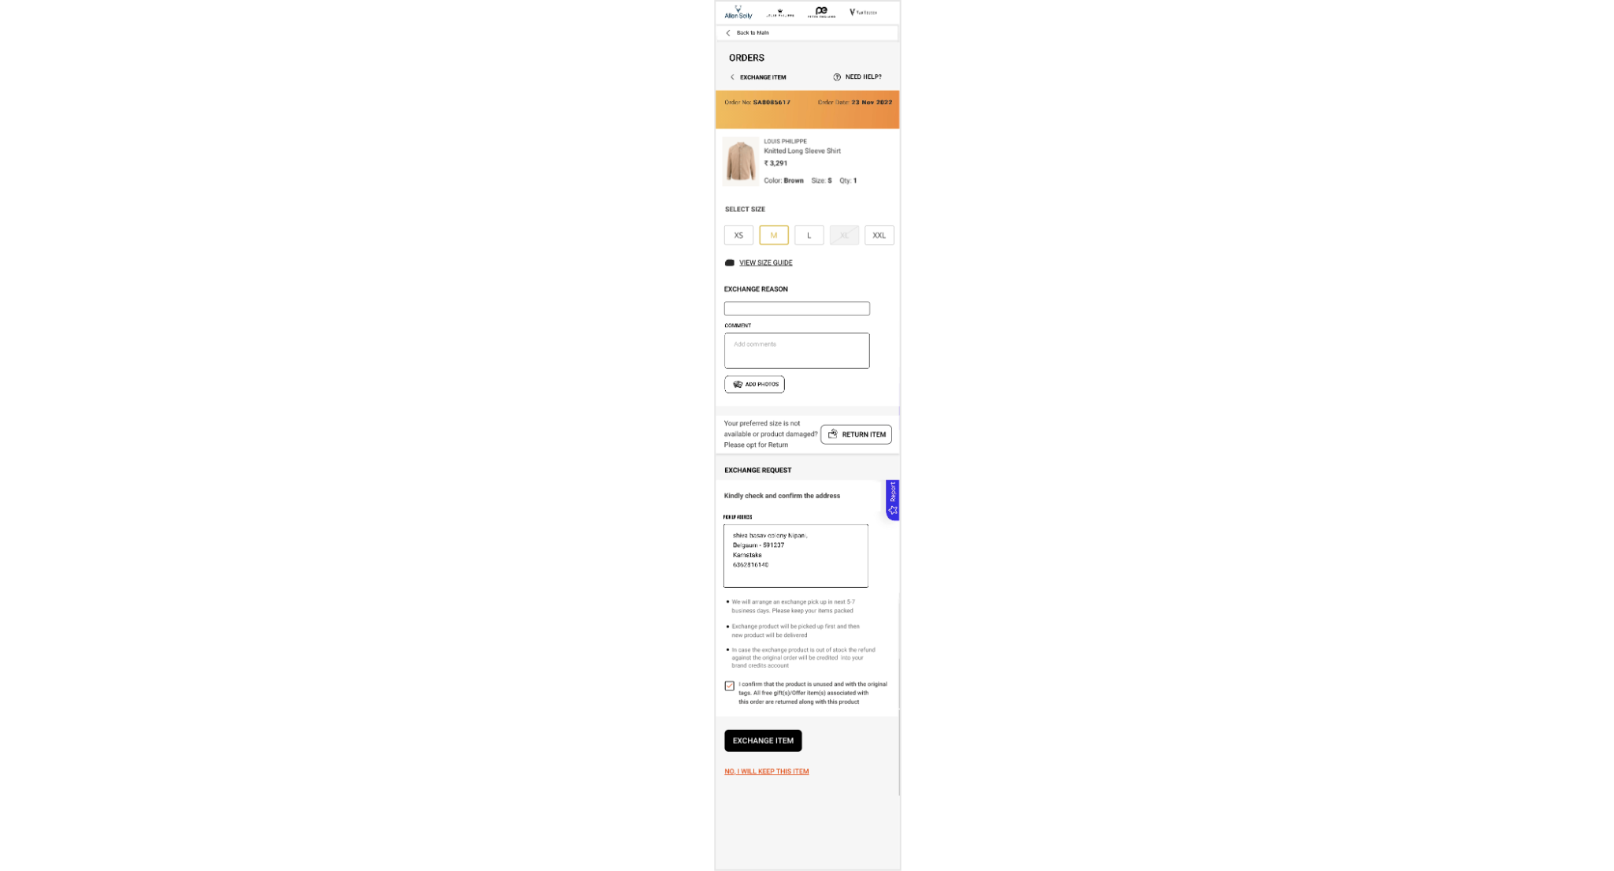
Exchange Page

Slide 13
Page type | Tracking type | Launch variables | Expected values
Exchange Page | On load | let contextData={ pageName: “exchange page”, channel: "<android/ios>|my account", customerID : "<customerID>", // only pass when available loginStatus : "<logged-in/guest>" , pageType : “my account - my orders page”, //my account-<pageName> platform: "<android/ios>", &&products : ";<product id>;;;;eVar19 = <product category>|eVar30=<product name>|eVar32=<product brand name>”,​ userDetails: "<gender>|<age>", // pass only when user has logged in dob: "<date of birth>" // pass only when user is logged in // pass only when user has logged in }; ACPCore.trackState(“exchange page", contextData); | loginStatus may have the values:- logged-in Guest

Slide 14
On exchange item click

Slide 15
click type | Tracking type | Launch variables | Expected values
CTA clicks | button | let contextData={ linkName:“exchange item", channel: "<android/ios>|my account", linkPageName: “my orders page", customerID : "<customerID>", // only pass when available loginStatus : "<logged-in/guest>" , platform: "<android/ios>", &&products : ";<product id>;;;;eVar19 = <product category>|eVar30=<product name>|eVar32=<product brand name>”,​ userDetails: "<gender>|<age>", // pass only when user is logged in dob: "<date of birth>" // pass only when user is logged in }; ACPCore.trackAction(“exchange item", contextData); | loginStatus may have the values:- logged-in Guest

Slide 16
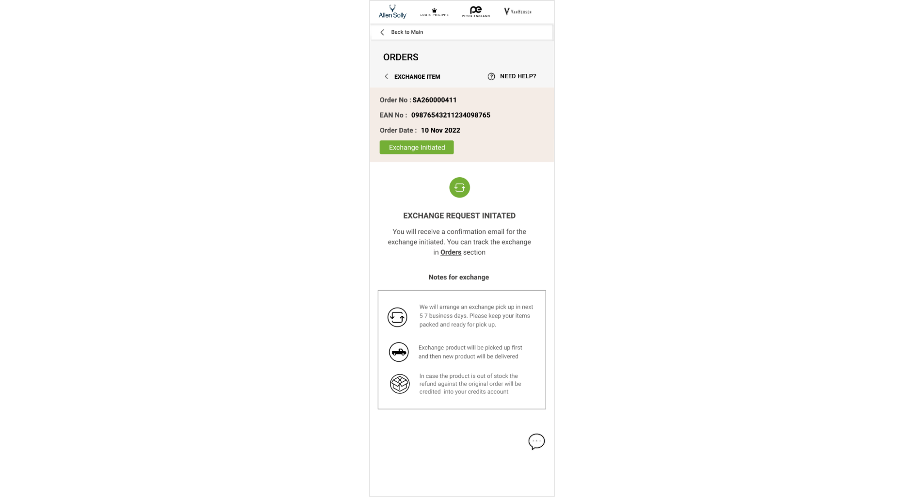
Exchange Initiated

Slide 17
Page type | Tracking type | Launch variables | Expected values
Exchange Initiated | On load | let contextData={ pageName: “exchange initiated page”, channel: "<android/ios>|my account", customerID : "<customerID>", // only pass when available loginStatus : "<logged-in/guest>" , pageType : “my account - my orders page”, //my account-<pageName> platform: "<android/ios>", excreason : “<reason forn exchange>”, &&events: “event97” // event97 only be passed when this page has loaded &&products : ";<product id>;;;;eVar19 = <product category>|eVar30=<product name>|eVar32=<product brand name>”,​ userDetails: "<gender>|<age>", // pass only when user has logged in dob: "<date of birth>" // pass only when user is logged in // pass only when user has logged in }; ACPCore.trackState(“exchange initiated page", contextData); | loginStatus may have the values:- logged-in Guest

Slide 18
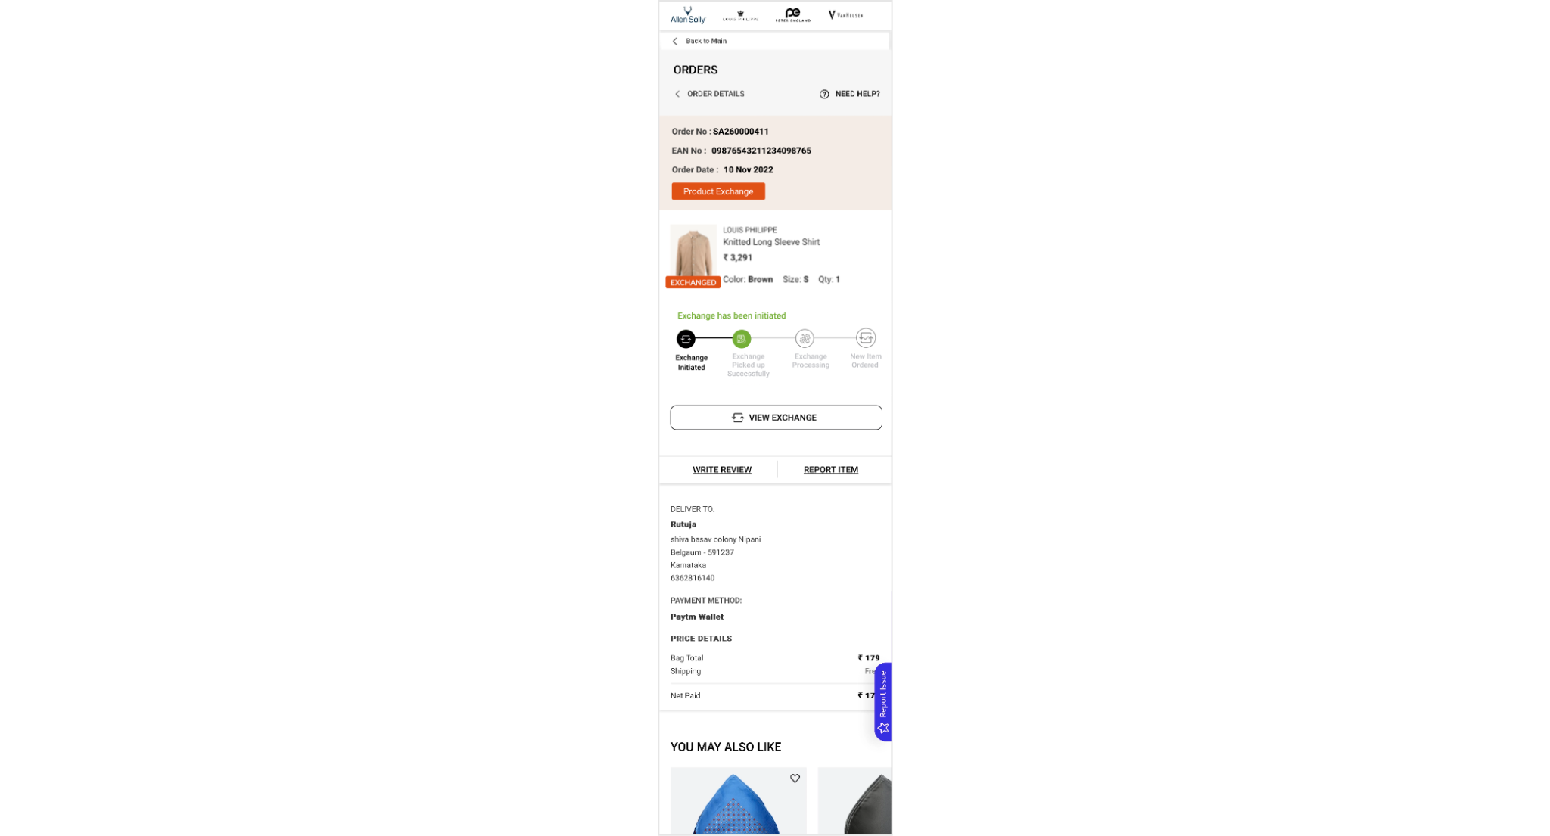
On exchange item click

Slide 19
click type | Tracking type | Launch variables | Expected values
CTA clicks | button | let contextData={ linkName:“view exchange", channel: "<android/ios>|my account", linkPageName: “my orders page", customerID : "<customerID>", // only pass when available loginStatus : "<logged-in/guest>" , platform: "<android/ios>", &&products : ";<product id>;;;;eVar19 = <product category>|eVar30=<product name>|eVar32=<product brand name>”,​ userDetails: "<gender>|<age>", // pass only when user is logged in dob: "<date of birth>" // pass only when user is logged in }; ACPCore.trackAction(“view exchange", contextData); | loginStatus may have the values:- logged-in Guest

